Slide 1
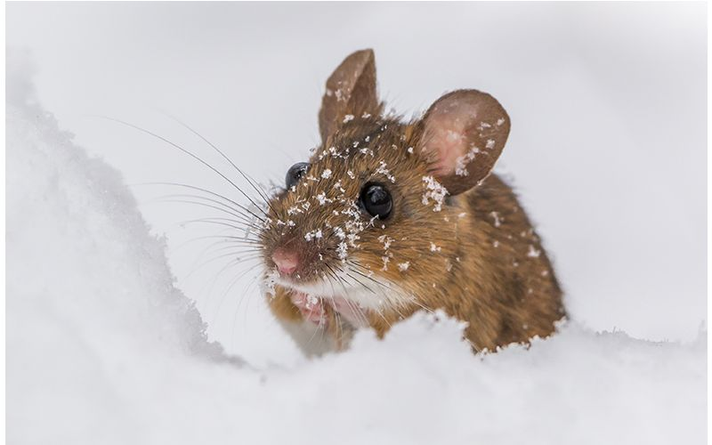
THERMOEGULATION IN RODENTS
Adapting to Environmental Challenges

Slide 2
TABLE OF CONTENTS
INRODUCTION
EXAMPLES OF RODENTS
RODENTS AS ENDOTHERMIC ANIMALS
STRUCTURAL ADAPTATIONS
BEHAVIOURAL ADAPTATIONS
PHYSIOLOGICAL ADAPTATIONS
COPING WITH COLD
COPING WITH HEAT
IMPORTANCE OF THERMOREGULATION
CONCLUSION

Slide 3
GROUP MEMBERS
NAME
INDEX NUMBER
Janice Ewurabena Williams
Kimberly Frimpomaa Ofori Berko
Turkson Jemima Love
Duah Georgina
Nimako Collins
Cephas Agbenorwu Mawuko
9220519
9214619
9220119
9207119
9213319
9196719

Slide 4
INTRODUCTION
Thermoregulation is the ability of an organism to keep its body temperature within certain boundaries, even when the surrounding temperature is very different.
This presentation highlights the various ways rodents adapt to different temperatures

Slide 5
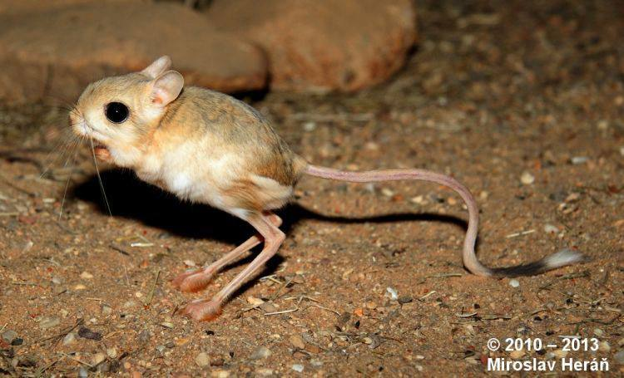
EXAMPLES OF RODENTS that undergo thermoregulation
Figure 1 kangaroo rat

Slide 6
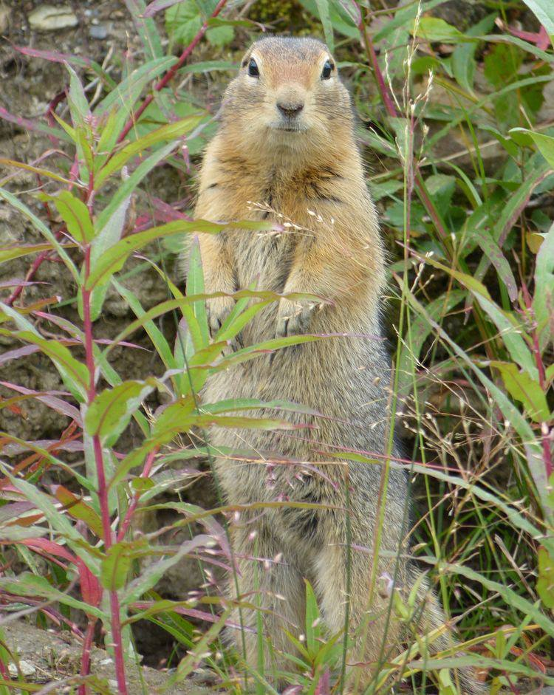
EXAMPLES OF RODENTS that undergo thermoregulation
Figure 2 Arctic ground squirrel

Slide 7
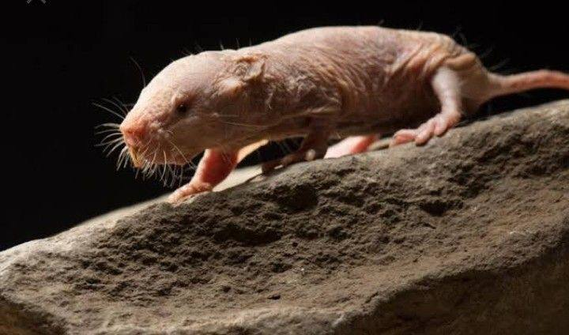
EXAMPLES OF RODENTS that undergo thermoregulation
Figure 3 Naked mole-rat:

Slide 8
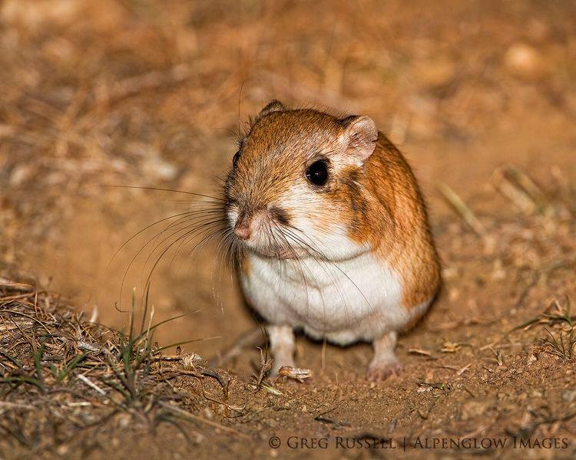
RODENTS AS ENDOTHERMIC ANIMALS
Rodents are endothermic animals, meaning they generate internal heat to regulate body temperature.
Endothermic rodents can maintain a relatively constant body temperature independent of the environment.
Figure 4

Slide 9
STRUCTURAL ADAPTATIONS
Insulation
Fat deposition
Counter-current heat exchange

Slide 10
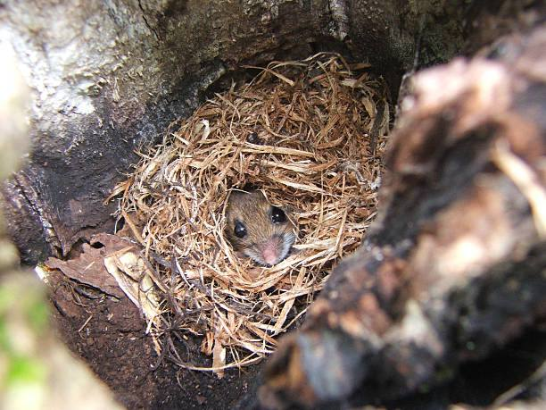
BEHAVIOURAL ADAPTATIONS
Rodents construct nests or burrows to shield themselves from extreme temperatures.
Fig.5 nesting in rodents

Slide 11
BEHAVIOURAL ADAPTATIONS
Rodents are nocturnal, allowing them to avoid the hottest parts of the day and conserve energy.

Slide 12
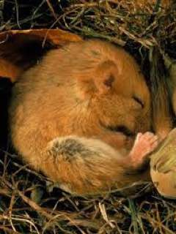
Behavioural adaptation
Hibernation
Fig. 7 hibernation in rodents

Slide 13
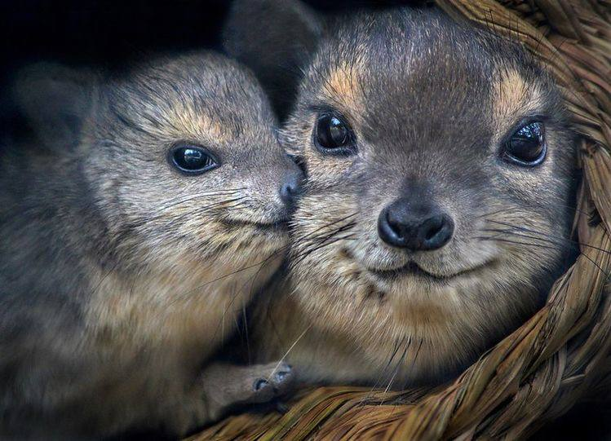
BEHAVIOURAL ADAPTATIONS
Social rodents huddle together to share body heat during colder periods.
Fig. 6 huddling in rodents

Slide 14
Behavioural adaptation
Estivation
Seeking shade and burrows
Grooming or bathing to lower body temperature.

Slide 15
Physiological Adaptations
Metabolic adjustments
Vasoconstriction and vasodilation
Sweating and panting

Slide 16
Physiological adaptation
Torpor: Certain rodents exhibit daily torpor, a temporary drop in body temperature and metabolic rate during inactive periods.
Enhanced insulation: Some species develop thicker fur or grow a winter coat to provide better insulation against the cold.

Slide 17
Importance of thermoregulation
Thermoregulation is critical for maintaining physiological processes within optimal ranges.
Disease prevention
Reproduction
Energy balance

Slide 18
conclusion
Rodents employ a variety of structural, behavioral, and physiological adaptations to maintain body temperature in different environments. Their remarkable thermoregulatory mechanisms allow them to thrive in a wide range of habitats. Understanding thermoregulation in rodents contributes to our knowledge of mammalian adaptations and may have broader implications in ecology and human health.

